Slide 1
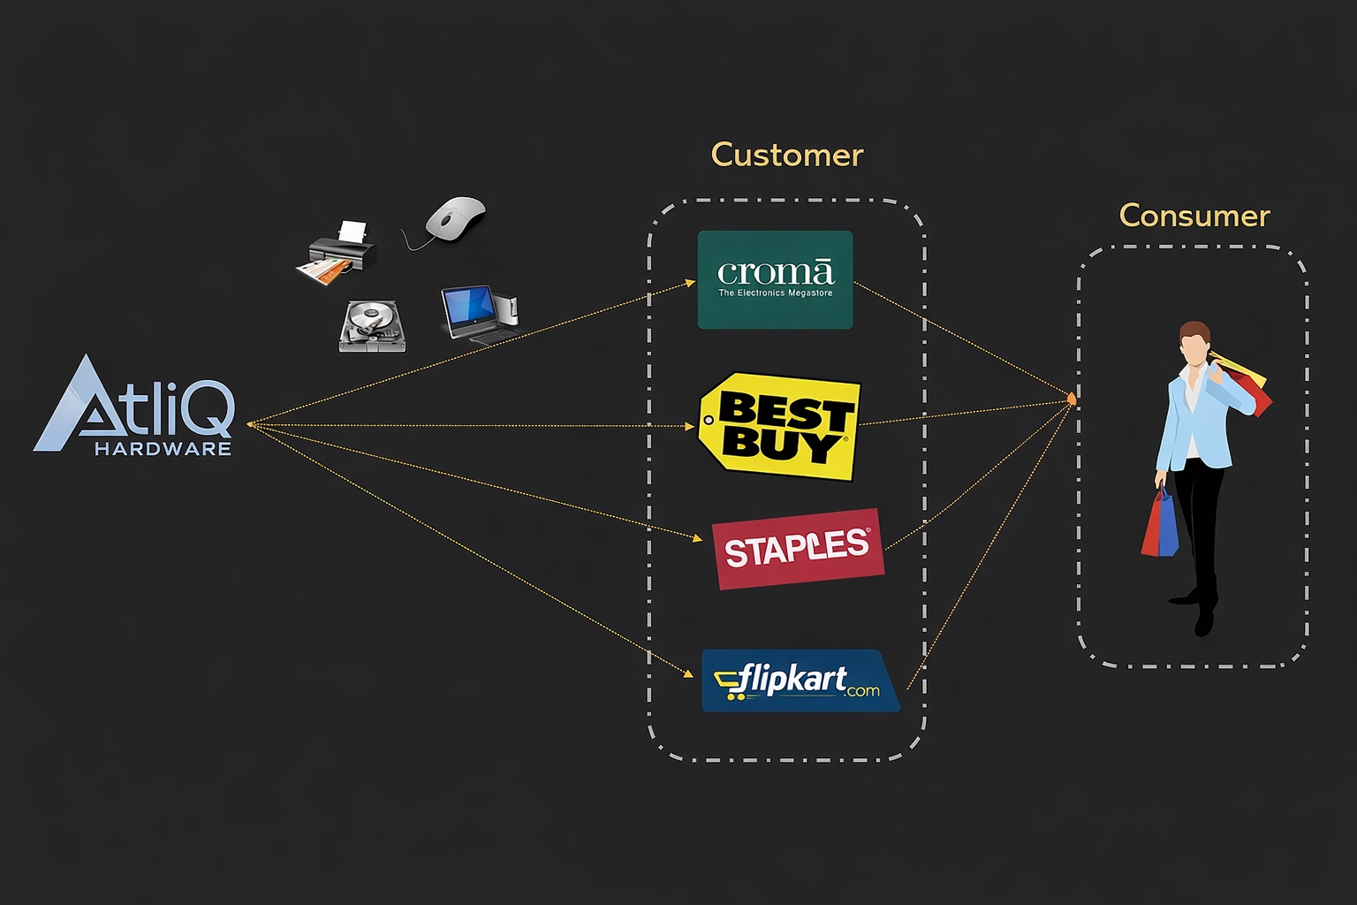
ATLIQ HARDWARE AND BUSINESS MODEL
Atliq Hardware is a global electronics manufacturing company that designs and distributes a wide range of hardware products, including laptops, printers, mice, and other computer accessories. The company serves customers worldwide through retail partners, distributors, and direct-to-consumer channels, supporting operations across multiple regions.
Presented by:
Poojitha Kolli

Slide 2
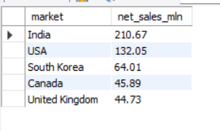
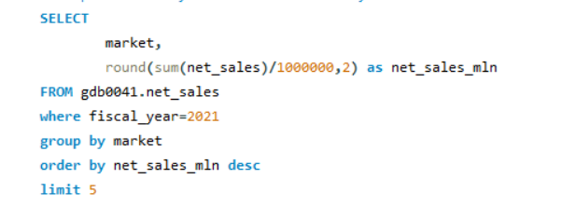
1. Top 5 markets by net sales
-- Get top 5 market by net sales in fiscal year 2021
Presented by:
Poojitha Kolli

Slide 3
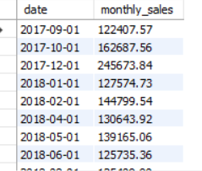

2. Monthly Gross sales report
-- Generate monthly gross sales report for Croma India for all the years
Presented by:
Poojitha Kolli

Slide 4
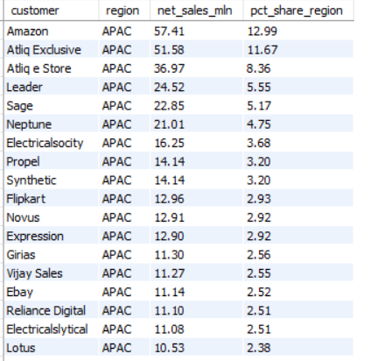
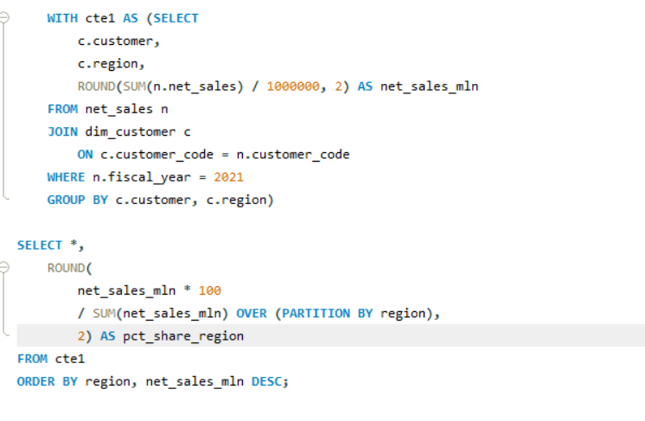
3. net sales % report
-- Generate a net sales % report of customers in different regions.
Presented by:
Poojitha Kolli

Slide 5
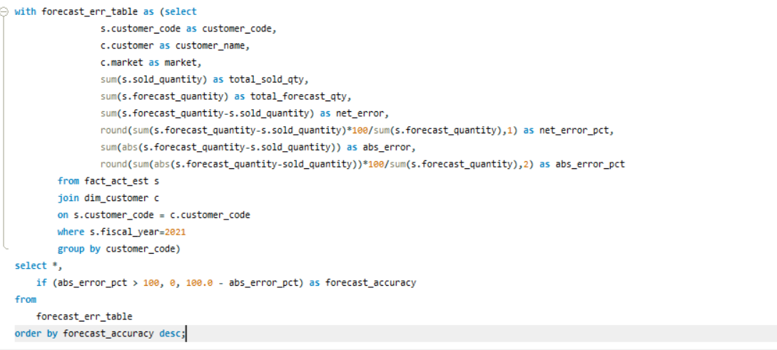
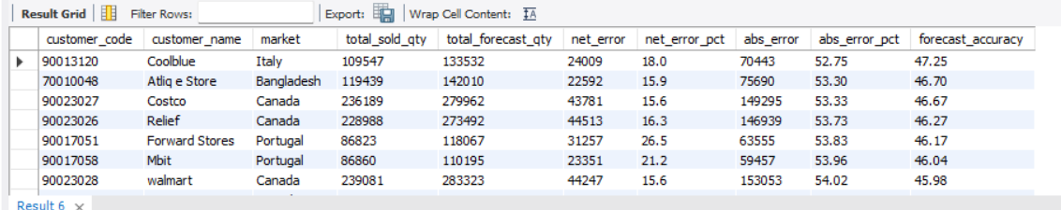
4. Forecast accuracy
-- Get forecast accuracy of FY 2021.
Presented by:
Poojitha Kolli

